Slide 1

Liming Cai, Russell L. Malmberg and Yunzhou Wu
BIOINFORMATICS, Vol. 19, Suppl. 1, 2003, pages i66–i73
Date: Feb. 14, 2008
Speaker: Chia-Hung Chang

Slide 2

Motivation: Modeling RNA pseudoknotted structures remains challenging. Methods have previously been developed to model RNA stem-loops successfully using stochastic context-free grammars (SCFG) adapted from computational linguistics; however, the additional complexity of pseudoknots has made modeling them more difficult. Formally a context-sensitive grammar is required, which would impose a large increase in complexity.

Slide 3
Results: We introduce a new grammar modeling approach for RNA pseudoknotted structures based on parallel communicating grammar systems (PCGS). Our new approach can specify pseudoknotted structures, while avoiding context-sensitive rules, using a single CFG synchronized with a number of regular grammars. Technically, the stochastic version of the grammar model can be as simple as an SCFG. As with SCFG, the new approach permits automatic generation of a single-RNA structure prediction algorithm for each specified pseudoknotted structure model. This approach also makes it possible to develop full probabilistic models of pseudoknotted structures to allow the prediction of consensus structures by comparative analysis and structural homology recognition in database searches.

Slide 4

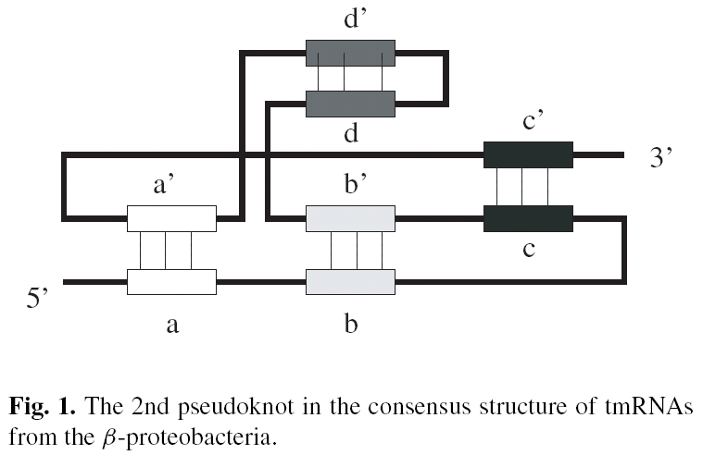

Slide 5

Input
  Given an input sequence x[1…n]
Output
  The sequence with base-paired annotations

Slide 6

Parallel communicating grammar systems
  One component can query sequences produced by others
  Several components can make queries at the same time

Slide 7

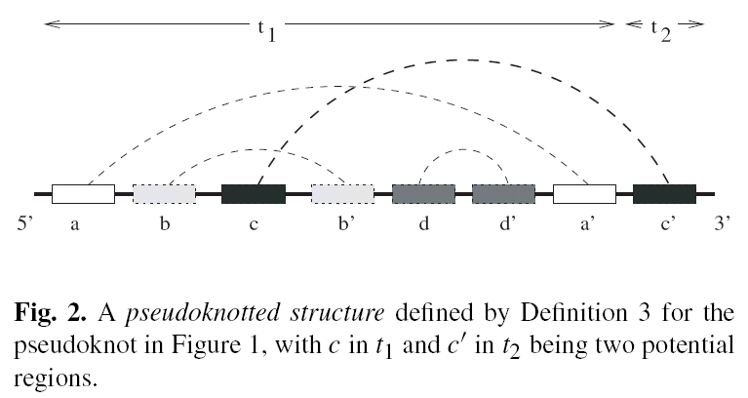

Slide 8

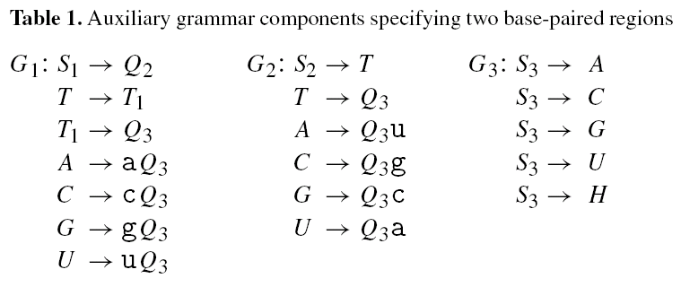

Slide 9
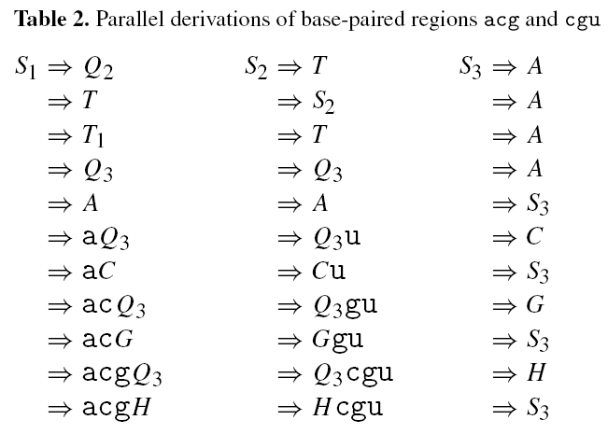

Slide 10
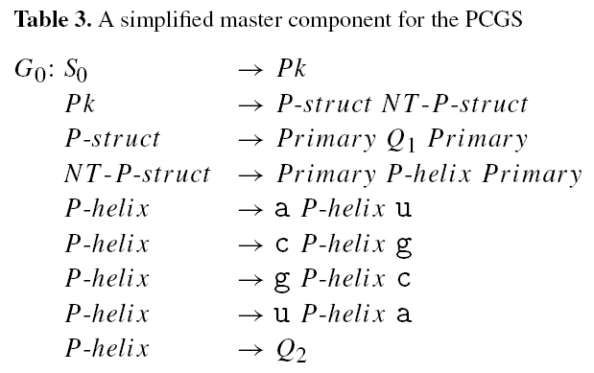

Slide 11
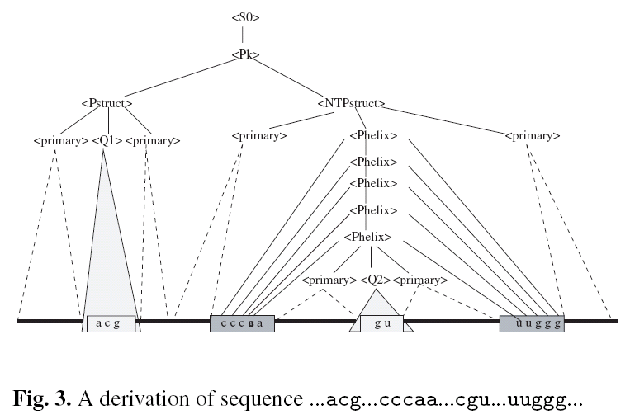

Slide 12
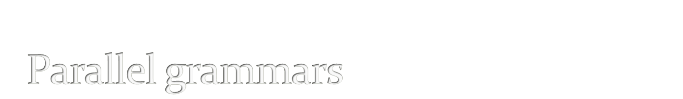
There’re 4 components in the PCGSs above.
PCGSs with 3m+1 components are sufficient to model PK structures, in which each P-structure can contain at most m potential base regions, m >= 1.
Each group of 3 regular components describes two remote base-paired region.

Slide 13

The most straightforward approach is to define a probability distribution for each component as an independent SCFG.
The probability of a parallel derivation step would have to take into account the conditional probabilities caused by communications between grammars.

Slide 14

The algorithm distinguishes three categories of substructures:
  Traditional stem-loops
  pseudoknots
  P-structures

Slide 15
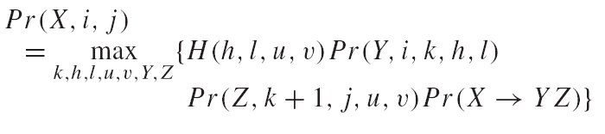
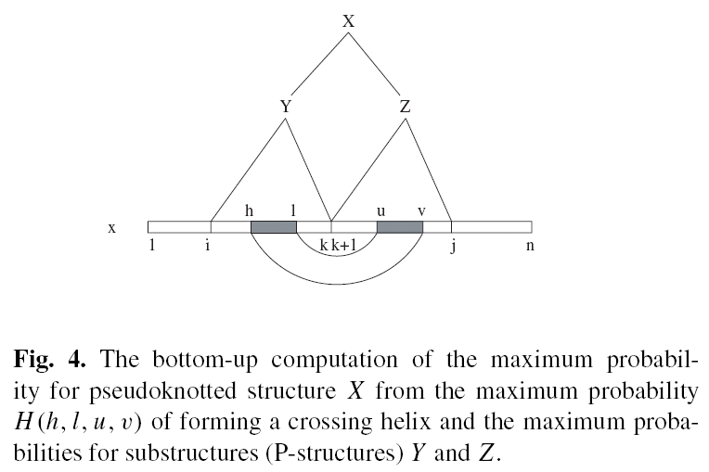

Slide 16
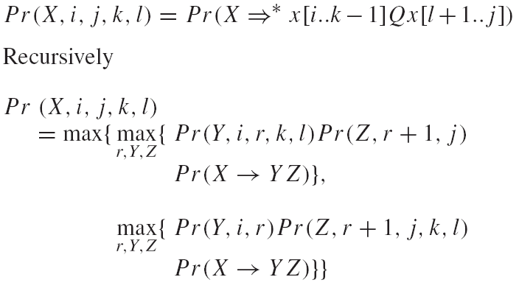
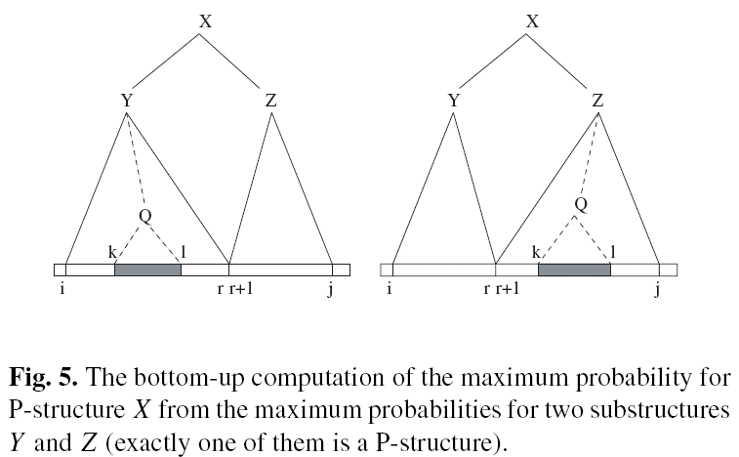

Slide 17

85 sequences that were aligned to each other and annotated.
Divided them into 2 sets
  42 sequences was used to estimate the probabilities.
  43 sequences to evaluate the success or failure. There’re (43-2-5) 36 sequences after all.

Slide 18
7 of 34 ➔ exactly correct
The rest 27 ➔ correct overall structure
18 of the rest 27 ➔ at most 3 changes
The rate ➔ (7+18) / 36 = 69%

Slide 19
